Slide 1
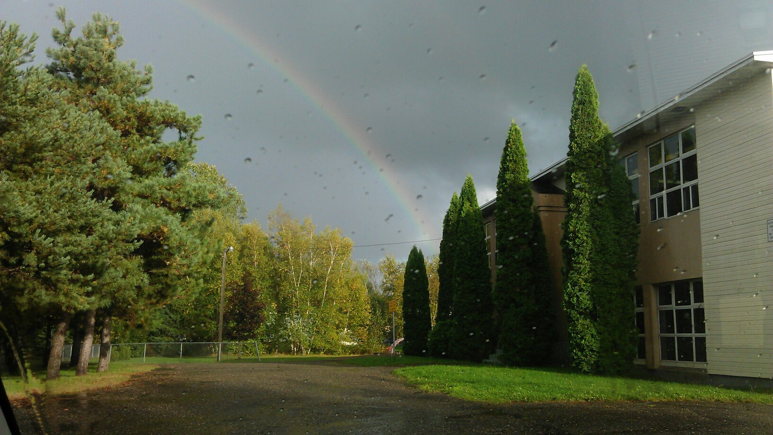
Burton Elementary School Matters
Notes:
BOTH
Introduce ourselves;
Who we are:
Our connection to Burton
And why Burton Matters to us

Slide 2
Purpose of Presentation
Introduction
Counter ASD-W presentation
Counter Burton Financial Comparison Report
Voices of the Future
Closing
Notes:
KRISTEN
This presentation by the Burton Elementary has five parts.
Introduction and explanation of slide format
Our response to the Superintendent’s presentation on October 13th, 2015 during the first public meeting.
Our response to the Burton Financial Comparison posted to the ASD-W’s website late November
To share the voices of our Students
And a short closing.
That is a lot to talk about so let’s get into it.

Slide 3
Name of Slide Slide # of Superintendent's presentation
Items in colour or added to the slide are to help highlight the discrepancies we found in the report.
The information here in the white box is the directly pulled from the Superintendent’s presentation in Meeting 1
Notes:
SARAH
We would like to give you an overview of the presentation set up.
The majority of the slides are data directly taken from the Anglophone West’s presentation on October 13th, 2015 during Meeting #1.
The text in the top left of this slide is the Slide title used in the Superintendent’s presentation
The number in the right side is the number of actual slide the information was taken from.
The white box in the middle is the direct information that was used in the Superintendent’s presentation.
To help rebut or raise interesting points we have added icons to the slides in the form of shapes, text or colour .

Slide 4
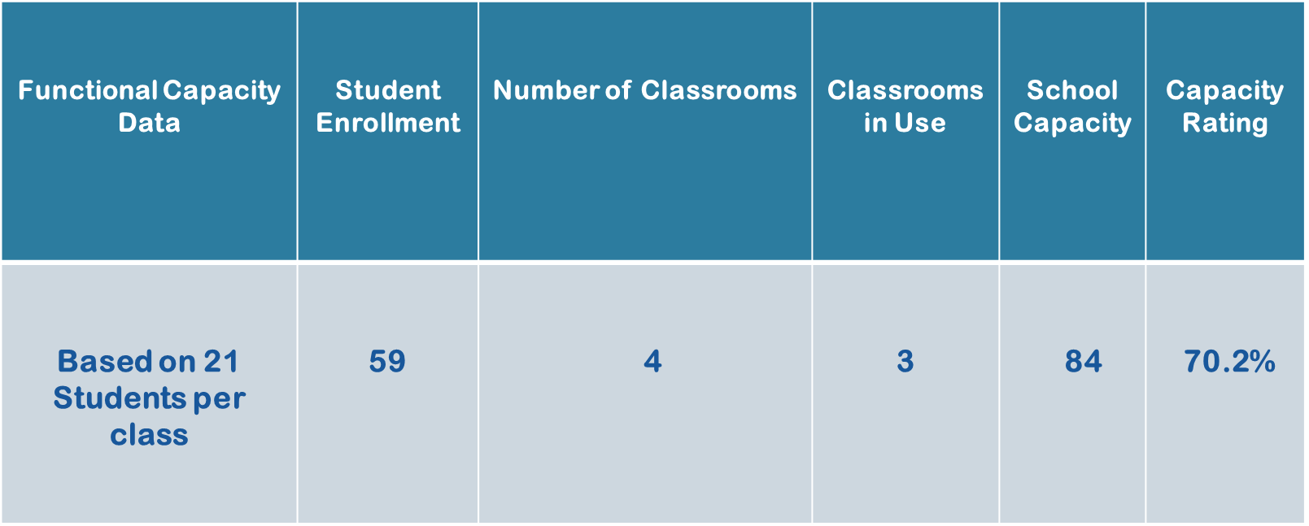
Functional Capacity slide 7
Notes:
SARAH
Talking Points
The information here was slide 7 of the Superintendent’s presentation during Public Meeting #1
Triggers are an important part of the 409 processes. As the DEC is well aware there are two triggers.
The first being Functional Capacity
During Public Meeting #1 The Superintendent stated that Ideal capacity is 60-80%
Burton is perfectly situated at 70%.
We are happy to share that we are currently at IDEAL capacity with three full grades.
The second trigger is a school population under 100 students
As stated in the slide above supplied by the Superintendent, Burton and all of us here are spending this December night here together as a community because of THIS trigger.
After using our sleuthing abilities and several phone calls, I have been told by the NB government that this trigger was put into place because their was a worry that the first trigger would appear to target too many Urban schools. “They thought it was a good number”.
Well it is not a good number and puts an unfair target on good, efficient and safe school.

Slide 5
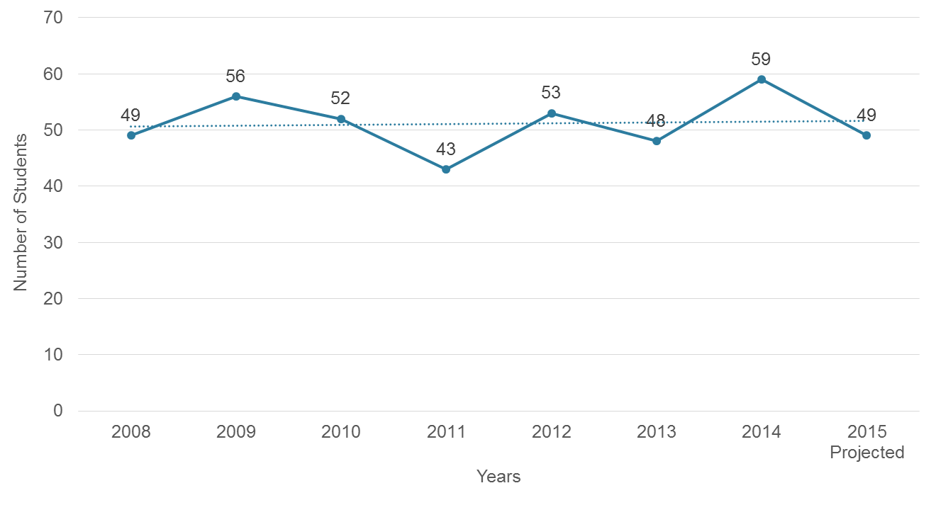
Enrolment Burton Elementary School slide 4
Was projected in 2011 to be 44 students.
Notes:
Kristen
Talking points:
This slide was taken from the 2015 Public meeting #1 made by the Superintendent.
He used it to show Burton’s population since 2008, you can see it is roughly around 50 students. The difference you will see is the BIG RED mark. What makes it so special? 53 students in 2012.
In the 2001 sustainability study which voted to keep Burton open, the Superintendent projected the enrollment to be 44. It was in fact 53. This is quite a difference. The district’s projection models do not work for Burton. We are an always changing community because of our Military ties. When soldiers and their families are posted to CFB Gagetown their message states they are moving to Burton, not Oromocto.

Slide 6
Projected Enrolment Burton Elementary School slide 6
Notes:
Kristen
The data here is from slide 6 of the Superintendent’s Public meeting number #1 presentation.
- In 2015 he projects once again a decline in enrollment. We have already shown that the districts projection models are not accurate. We already have 11 Kindergarteners enrolled for the 2015-2016 school year AT Burton and this is before the 2016 posting season.

Slide 7
Core Curriculum slide 13
Core Curriculum | Burton as seen by District | Burton Actual
Early French Immersion |  | Grade 2 students have scheduled instruction time with a FSL volunteer
Science Lab | No | Science cluster; hands on; science is more than one room.
Computer lab | No | Mobile cart. Room is where the students are
Music/Arts specialist | No | Christmas play, monthly assemblies
EST-Technology | Request Support | Same as all elementary schools
Gymnasium | No | Architectural plans -YES
Notes:
SARAH
For ease of understanding we have taken the information from Slide 13 of the Superintendent’s presentation and placed some information in the first two columns. Our rebuttal is in the last column.
En regard to Early French Immersion: Currently early French Immersion starts in Grade 3 which is outside our school parameters. But Burton school is where Stars shine and that has not stopped our introduction to structured French time with the partnership of a local French Second Language volunteer.
Primary children will lose too much "time on task" shuttling to and from science labs and/or computer labs when they require experiential learning in the classroom where what they are engaged in doing relates directly to the concepts being taught.
A Science Lab isn’t just about beakers and Bunsen burners. A “lab” can be in the classroom, at home, or out in the field—anywhere that provides students with the opportunity to interact directly with natural phenomena or with raw data. Much of the primary curriculum is interconnected so science can occur during language arts or math for example.
Burton school does not have a designated classroom for computers. Our space is too valuable. Computers belong in the classrooms where they are readily accessible. Suggesting that Burton School is inadequate in providing this type of learning because the building does not have labs is counter to best practices in primary education.
No Burton does not have a Music/Art specialist in house but once again that does not stop our school. There are monthly assemblies hosted by a different grade each month is full of poems and songs. Our yearly Christmas Concert has over 200 people attend. Our halls and classrooms are full of designs, colours and techniques that the students learn and refine.
The community was shown mixed information in October. The data above stated Burton Elementary did not have a Gymnasium where later…

Slide 8
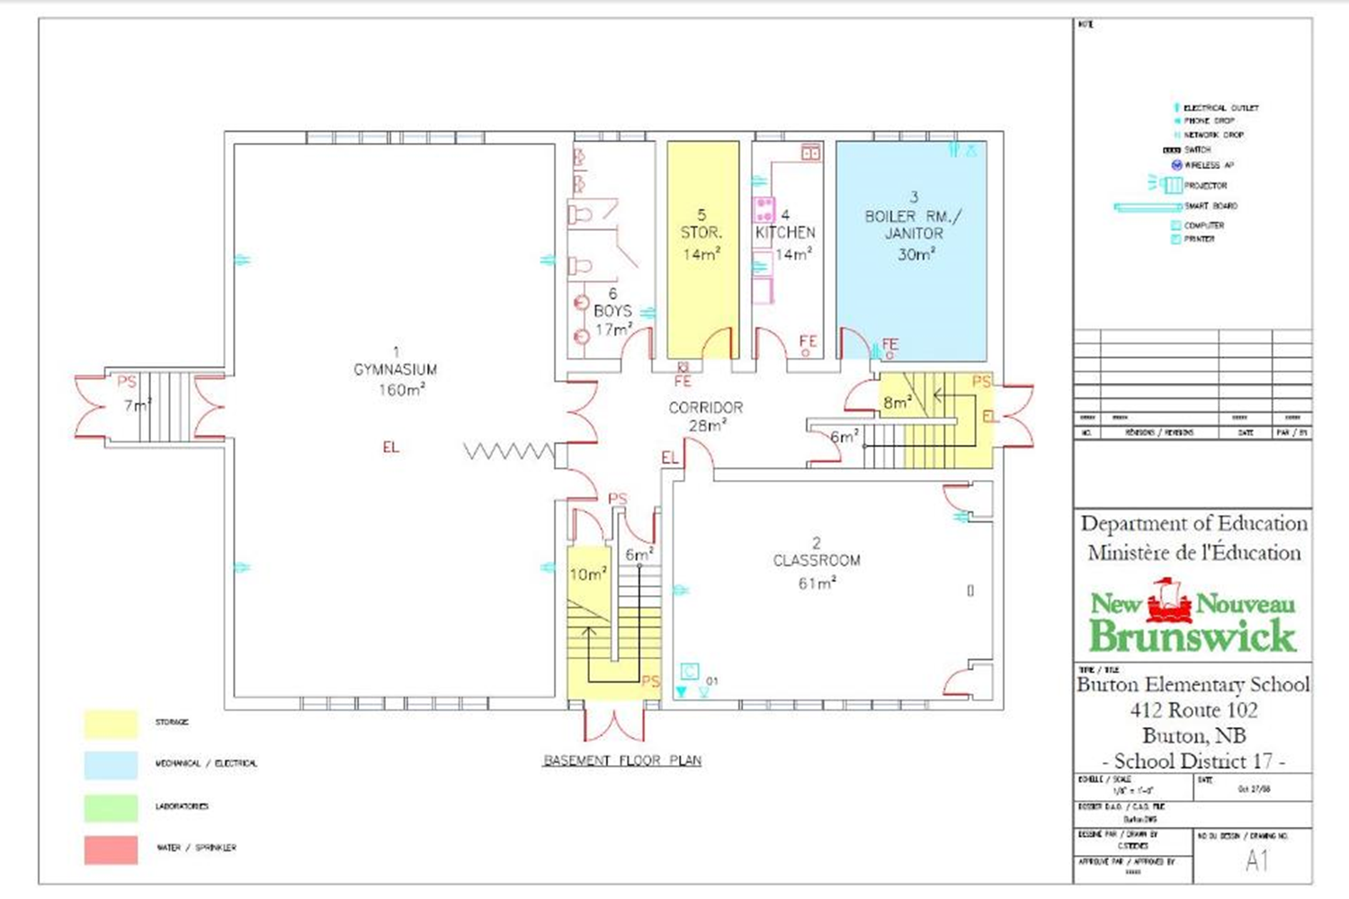
Burton Elementary School slide 23
3
Basement
Notes:
SARAH
One slide 23 of the Superintendent’s presentation, you can see here Burton has a gymnasium on the basement floor of the school.

Slide 9
Small School Research
Thirty or more years of research bore out the finding that small schools are safer, offer better teaching, and result in higher academic performance.
The most important benefits include:
• Raised student achievement
• Increased attendance
• Elevated teacher satisfaction,
• Improved school climate
Grauer, Stuart R. (n.d) Small versus large schools: The truth about equity, cost, and diversity of programming in small and large schools. Retrieved from http://www.communityworksinstitute.org/cwjonline/essays/a_essaystext/grauer_smallsch1.html
Notes:
KRISTEN
I am an evidence based person, in my line of work facts and data are important. This summer I did a lot of research on Small Schools. I was shocked at the amount of evidence supporting the benefits of smaller schools.
Small school teachers feel more committed and connected in their work, and they report higher job satisfaction and a greater sense of responsibility for ongoing student learning.
Small school parents are closer and have higher levels of involvement, and parental involvement is a critical factor in student success.
Small schools have a leaner administrative structure, and the consequence of this is that the whole faculty shares in decision-making;
Students in small schools were reported to outperform students in large schools on standardized achievement tests, and significantly so (6 studies)
Small schools create more opportunities for participation per capita.
Smaller schools may be especially important for disadvantaged students by more individualized attention and teachers being able to address different learning styles.
Note Peggy’s Fry letter which demonstrates how Burton Elementary exemplifies this.

Slide 10
Grade 2 Provincial Testing 2011, 2015, School
Year | Burton School | District | Province
2006 - 2007 | 88.9 | 80 | 72
2007 - 2008 | 66.7 | 82.7 | 76.1
2008 - 2009 | 92.9 | 87 | 82
2009 - 2010 | 75 | 72.5 | 83.6
2010 - 2011 | 71.4 | 75.8 | 80.3
2011 - 2012 | 64.7 | 78 | 79.1
2012 - 2013 | 68.4 | 80.3 | 79.5
2013 - 2014 | 91.7 | 76.8 | 77.5
2014 - 2015 | 68.7 | 58 | 54
Average | 76.4 | 76.7 | 76.0
Notes:
KRISTEN
The data on this slide is a combination of the Grade 2 Provincial Testing results given by the current Superintendent during the 2011 and 2015 sustainability study and we were able to add last years 2014-2015 school year results.
We have used nine years of data to find the averages for Burton School, the District and the Province of New Brunswick. That is the number across the bottom.
The rows in peach are the years that Burton Elementary out preformed the District and/or the Province. You can see it is often done by more than 10%.
The years that Burton falls below the standard can be because of the small population set. Students that learn best on an Individual Education Plan (IEP) or modifications affect our scores greater. One student in 19 has a bigger impact than 1 in 1000. That is 5%.

Slide 11
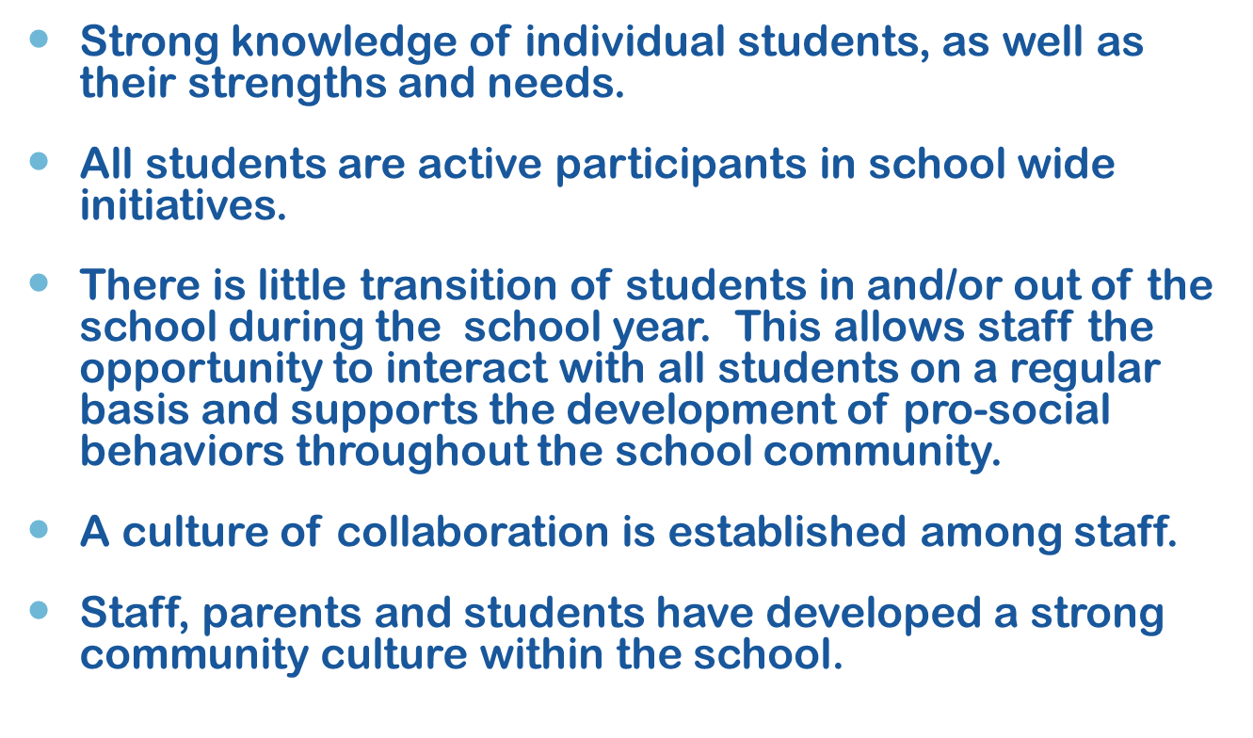
School Benefits slide 20
Notes:
SARAH
This I think was my favourite slide from the Superintendent’s presentation in October.
We have an amazing staff at Burton Elementary. The Staff, from the principal to the Janitor go out of their way to get to know the students and their families. When students come to Burton Elementary they stay. This allows staff to build skills and students inside the mind and heart.
Burton Elementary is more that an school, it is a community. Many schools have to do activities and events in sections, grades or single classrooms. It is wonderful to know that all 60 students KNOW each other. They go skating together as a school, they support and feel joy when their friend earns a student of the month certificate because they know how hard they worked. The culture built inside the classroom carries out into the community of Burton where when you see someone at the “Slushie Store” the kids are excited to see each other and an otherwise brief nod becomes a smile and conversation.
Early elementary is a great place to enstill pro-social behaviours for a mindfull and stressless life. Burton has done this by implementing the Bucket filling program, teaching and demonstrating WITS, creating mentor and leadership programs with the Burton Buddies, Bus Buddies and Bathroom Buddies (sometimes you just can not reach the taps) and three years ago students identified the “friendship bench” themselves.
The school is part of our community. The Staff look for ways to intergrate different community members, orgainizations and business into daily activities, celebrations and events.
Some examples are:
Creating crafts for local senior centre.
apple picking within walking distance,
The Terry Fox run,
Community Safe Halloween,
Community Volunteer Dinner with 40 invited guests,
Community Curriculum open house nights,
school is used by Sparks,
beginning to have after-school program for whole community at Burton School.
“Look at hall, see the variety of people presenting and contributions of our families ”

Slide 12
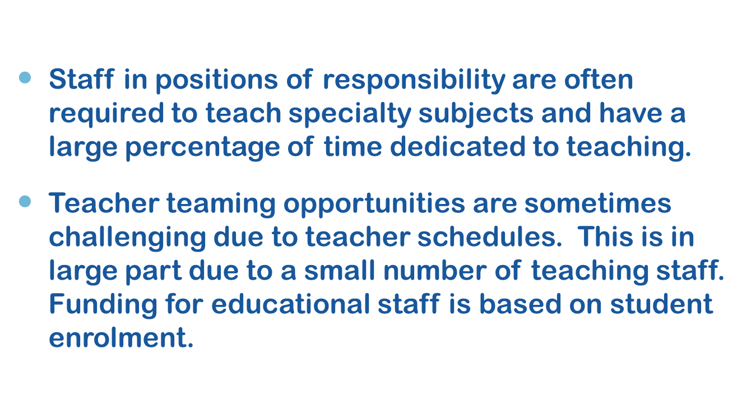
School Challenges slide 21
Notes:
SARAH
We have crossed out the word “Challenges” from the title of slide 21 of the Superintendents presentation, we just do not the see this slide as challenges. Many of them work in the favour of our Students and school.
Talking Points:
Principals are first and foremost teachers. Teaching gives the administrator a chance to keep his or her teaching skills current in practice and to be a collegial member of the teaching team. This does not have to be seen as a challenge but as we see it, an opportunity. Until recently Burton School did not have an administrator on site as it was attached to another school therefore the principal was only on site a few times a week. We love that our principal is on site and such a good teacher. (I know that my children LOVE Math because of her).
In the previous slide the Superintendent stated that there was a “culture of collaboration is established among staff”. We absolutely agree! We do not see why a small group of teachers in a small space are at risk of not teaming or sharing their expertise with one another.
Finally the decrease in funding for educational staff is a District likely provincial wide issue. We would like to remind you of the letter sent by Assioboine PSSC late last Spring to the DEC which the Burton PSSC supported, requesting an increase to Educaitonal Support Staff such as Guidance, Numercy & Literacy Leads and other resources. In the current education situation this is a need and a challenge for all schools.

Slide 13
Building Summary slide 22
Notes:
KRISTEN
The Superintendent supplied the DEC with a Building Summary during the 1st Public Meeting in October.
In 2011 a provincial report was commissioned to assess the status of all schools older than 50 years old. Many schools found significant concerns where as Burton was found to be in good structural condition. Not all schools faired as well.

Slide 14
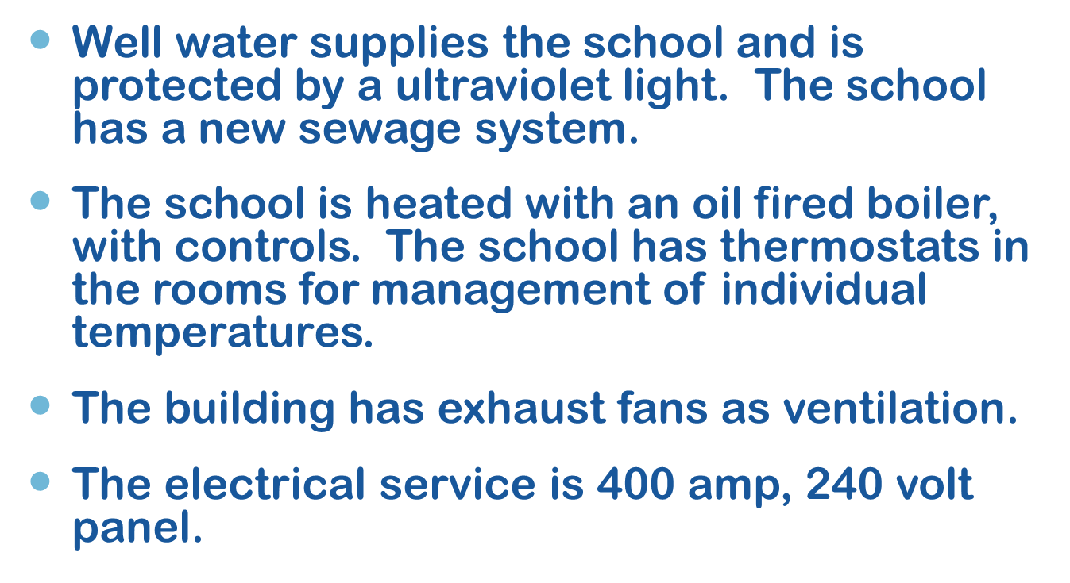
Building Systems slide 25
Notes:
KRISTEN
This slide continues with the building summary as given by the Superintendent in October.
In addition to the points on the slide we feel the DEC should know that:
#1- There are no concerns about water quality in Burton. Since February 2012 Burton has successfully passed all water testing.
- Testing is done monthly.
- Other schools in the Burton area have not been tested unless there is a concern raised by the community or the directly school. The district rely on the town's water supply and testing results.
- This does not take into account any leakage of heavy metals that can occur over time. Heavy metals have been shown to affect developing minds.

Slide 15
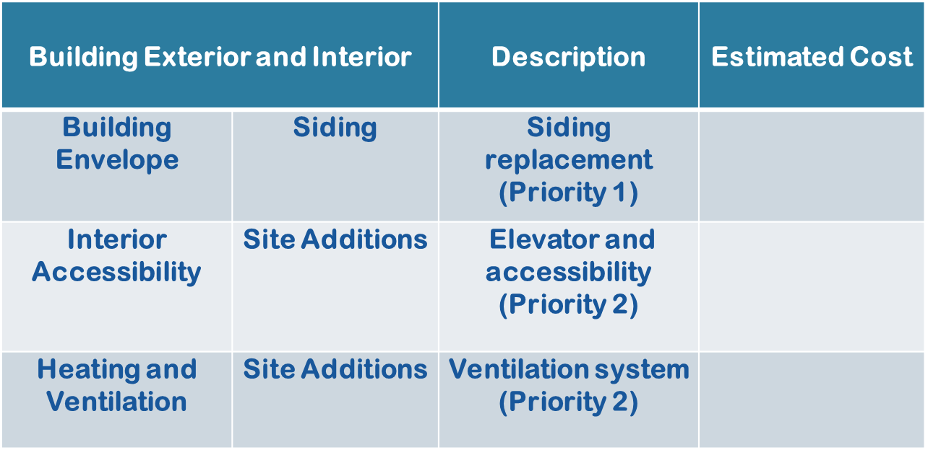
Physical Plant Status slide 30
$ 37 000
< $50 000
$ 157 000
Notes:
KRISTEN
The Superintendent shared with the DEC and public items that are currently on the Burton Elementary School Capital Funding list. The information above shows our ONLY Priority 1 concern and two of the three priority 2 items. The numbers in red are from the 2011 sustainability study where both of the items were also on the Capital funding list then. We have reached out to local contractors about the ONLY priority 1 concern and the feel that $37 000 continues to be a realistic estimate.
In November the Superintendent supplied the community via the sustainability discussion board with an estimate of < $50 000 for priority 1 projects.
Electrical is more than a Burton School issue. It is also on other schools, for example, Assiniboine Avenue Elementary School’s Capital School budget which totals more than $807 000.
Talking Points- This was talked about in Ross’ presentation.

Slide 16
Salaries slide 37
Increased number is due to over capacity Kindergarten class.
Notes:
SARAH
In October the Superintendent used this slide to show the salaries for Burton Elementary over the last 3 years.
DEC member Donald Gould ask, “costing is important, in 2014-15 a teacher was employed for 6 months to make it higher, should this not be reflected?? “ We agree but have yet to see documentation reflecting this concern. This unfair number was also used in the Burton Financial Comparison Document as a baseline. We feel this falsely raises the cost and changes the financial optics of our school.
Was touched on in Ross’ presentation

Slide 17
Total Costs slide 40
8.3% = $ 39 603 is facilities cost.
Notes:
KRISTEN
The Superintendent told the DEC and community members at the 1st Public meeting in October that the total cost to run Burton Elementary in 2014-2015 was $ 476 077.
We think this number is untrue for the following reasons:
The total cost is the combination of yearly salaries PLUS facilities costs.
We have already discussed the fact that the current number being used for salaries is inflated as it also includes the cost of an extra teacher due to a grade being over capacity.
Therefore the true savings based on the information presented by the Superintendent in October would be the facilities costs such as (Cleaning, snow removal, electrical, garbage, oil for heating and minor repairs).
The saving costs is $39 603.
Only 8.3% of the current enlarged Burton Elementary School total cost budget,
which would amount to be in consiquential when looking at the over 200 million dollar District budget.

Slide 18
Impact on Burton Community Slide 44
Notes:
SARAH
It is hard to believe the Superintendent was able to fit the impact on Burton Community on just one slide in October.
The impact of Burton Elementary of whether it closes or stays open is indescribable. But let me try.
Burton Elementary is the reason why people CHOOSE to buy, raise their children and later stay here. If the school was to closed this would devastate the housing market, businesses and any sense of independence Burton has.
Our close community ties go beyond the edges of the school yard. This was evident in the our fundraisier two years ago where local businesses bought ad space in a calendar. There was such an overwhelming response that the fundraiser was creating profit even before we went to press.
Later Michelle will talk more about the Impact of the Community in her presentation.

Slide 19
Financial Considerations Document
Notes:
Kristen
The Superintendent continues to have inflated or mistaken data. Over the next few slides we will show you why we feel this way.

Slide 20
Financial Considerations Document Total Annual Savings
$ 167 780
$7 752
$ 160 028
$ 37 726
Notes:
SARAH
Late November the Superintendent posted the Financial Consideration Documentation, or “what if” scenarios.
In it the Superintendent states that the total annual saving for creating a K-2 Assiniboine /Burton Elementary School would be $ 167 780. We feel that this is untrue. So took a closer look.
Let’s start with the number given, $167 780.
(click) The first cost given was the Principal bump up. In correspondence between the PSSC chair and the Superintendent we know that this cost will be ongoing for a number of years. And would resolve due to retirement. We do not feel that this should be included.
Which leaves us with: (click) $ 160 028
The next is the cost of 1.1 FTE. Looking at the salary given it more in line with the current salaries of Burton Teachers. As earlier stated Burton Teachers are all tenured with 10 or more years of experience. (click) Therefore they would “bump” another less experienced and/or contracted teacher and the cost would more likely be $37 012. The difference between the truer cost and the one in the document would be $37 726.

Slide 21
Financial Considerations Document
$ 122 302
$ 38 049
$ 8 500
Notes:
SARAH
Which would the total down to $122 302.
(click) Then came the total savings from Global school budget and facility operational budgets. This number is slightly lower that the presentation in October and as stated earlier we fill this is the true and only savings. So we will leave it. (click)
Finally came the ever elusive and foggy bussing. (click) After several emails and request for clarifications we are still unsure how there will be any savings for busing. Currently Burton School uses one full bus to bring its students to and from school. We believe that there will be no savings in bussing and there fore this is red herring aimed to create an illusion.
Which means that based on the Superintendents numbers and formula the for closing Burton School would be:

Slide 22
Financial Considerations Document
Possible annual savings
$ 113 802
Notes:
SARAH
With this quick relook… a possible annual savings could be:
(click) $113 802
That is a difference of $53 978. Wow!

Slide 23
Financial Considerations Document One-Time Cost Avoidance
The capital improvements list include:
Siding Replacement
Elevator and Accessibility
Ventilation System
Power Distribution, Panels and receptacles Upgrade
Upgrading Old Ceiling and Lighting
Curbing and Driveway Refinishing
Notes:
KRISTEN
The Superintendent states that Burton has 6 items on its Capital Improvement list. We have already stated that only one is a Priority One item. Which means with the lists of other schools and the districts resources there is truly only one item on the list. (click 5 times)
Siding Replacement.

Slide 24
Financial Considerations Document One-Time Cost Avoidance
$ 573 000
$37 000
Notes:
KRISTEN
$ 573 000 is NOT the true capital improvement cost. (click)
More rather it is the cost of siding alone, which was stated to be (click) $37 000.
Difference is $ 536 000

Slide 25
Voices of the Future
Notes:
SARAH
We are here because Burton School Matters. It matters to everyone here in this room and most importantly it matters to the children of this community. Because of their age our students do not have a way to share how they feel about this process. We wanted to make sure that the voices that mattered DID have a way to tell you the DEC members why they think Burton Matters.

Slide 26
Hear it from the Students
What our Students like:
41% liked subjects: Math, Gym, or Art
18% liked class specific activities: Star student, Morning Message
41% liked school wide activities: Clusters, Running club, our improved playground
Notes:
KRISTEN
We are unable to use the “Hear it from me Survey” the older student complete. Therefore I went into the school one afternoon and asked ALL the students what they liked and did not like about Burton School.
Here is a synopsis of the answers.
THERE WAS A STUDENT THAT WAS NEW TO THE SCHOOL THIS YEAR AND SHE WAS ASKED WHAT SHE LIKES BETTER AT BURTON OVER HER PREVIOUS SCHOOL, SHE THOUGHT THE MATH WAS TAUGHT BETTER.

Slide 27
Hear it from the Students
What our students disliked:
46% disliked NOTHING.
11% disliked outside of school stuff that affected their day
The remainder was a mis-mash of items, Gym, playing with Lego, etc..

Slide 28
Burton Summary
Impact on Community:
Closing Burton school will significantly change the demographics of Burton.
Currently we are an ideal young family community.
Cost to District:
District is looking to save 8.3% of our little school budget which is inconsequential to the Districts overall budget.
Amazing Quality of Education:
Our students have strong minds and hearts. Learning in this small rural school has given them a strong foundation for the rest of their life.
Notes:
SARAH
We are more that mortar and bricks,
We are the future of Burton,
We are partners with local service groups and businesses
We are where the community comes to play and learn.
Our school is unqiue.
Our school is a community school.
Burton School matters!
KRISTEN
(click)
Inclosing I would like to revisit these three important points.
Impact on Community
Closing Burton school will significantly change the demographics of Burton.
Currently we are an ideal young family community.
Cost to District:
District is looking to save 8.3% of our little school budget which is inconsequential to the Districts overall budget.
Amazing quality of education-
Our students have strong minds and hearts. Learning in this small rural school has given them a strong foundation for the rest of their life.

Slide 29
Questions ?
Notes:
-If they ask simply say you referred to a number of education research articles and they all say pretty much the same thing. Invite the DEC to have a curriculum supervisor present good primary school practices to them sometime so they can be kept current!

